Slide 1
Nonprofit Board FELLOWS Program 2015 - 2016
Wharton Leadership Program
Information Session

Slide 2
Agenda
Introductions & Program Overview
Leadership Team
Roles
Fellowship Overview & Commitment
Current Fellows
Questions

Slide 3
Wharton Leadership Program Mission
“
To develop leaders who act with a deeper understanding of themselves, their organizations, and their communities, and contribute positively to the growth of each.
“

Slide 4
NBF Program Overview
Vision
To be the experiential leadership development program at Wharton that educates MBA students on nonprofit board governance
Mission
To develop MBA students as leaders who seek a life-long commitment to community involvement and board service, resulting in value creation for nonprofit organizations and communities

Slide 5
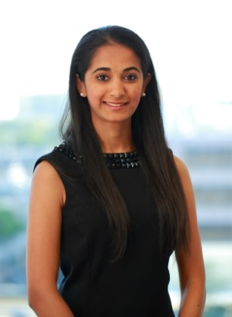
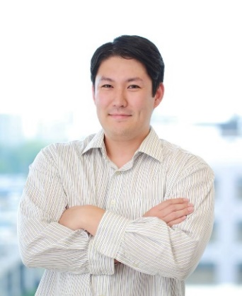
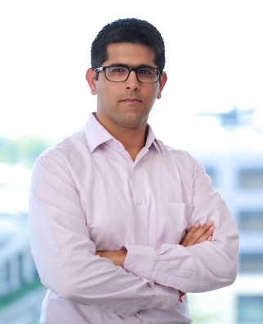
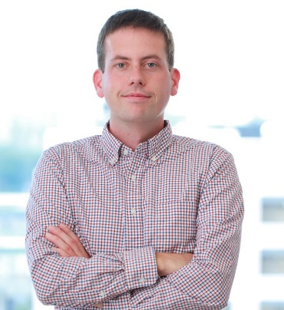
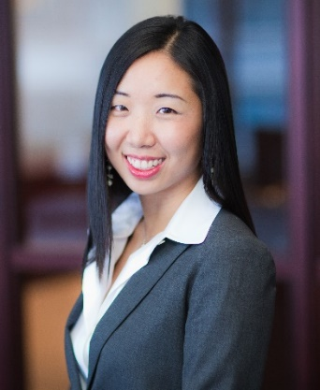
Nonprofit Board Leadership Team
Dan Kaufman
Associate Director, NBFP
Divya Krishnan
Jonathan Shintaku
Akshay Mandan
Eamon Nolan
Jeannie Chen

Slide 6
Nonprofit Board Fellow Program Structure
Associate
Director
BF selection
Partnership management
Program meetings
Content expertise
Trainings
Mastermind meetings
Leadership
Team
Board
Fellows
Community building
Pod meetings
One-on-ones

Slide 7
NBF Coordinator (“BFC”) Role
“Fellows to the Fellows”: peer leaders that build and maintain close relationships with the class of Board Fellows
Have previous board experience
Shape program through recruitment, selection, and development of Board Fellows community culture
Mentor a “Pod” of 8-10 Board Fellows through challenges in monthly Mastermind and one-on-one meetings – e.g., managing board conflicts, role discussions, etc.

Slide 8
Board Fellow (“BF”) Role
14 month commitment (March 2015 – graduation)
Approximate time commitment is 10-15 hours per month
Support mission and vision of a local non-profit as non-voting board member
Attend monthly Board and Subcommittee meetings
The majority of BFs complete a project with their non-profit
Develop relationships within your non-profit and Board Fellow community
Participate in monthly Pod Meetings with your BFC and monthly Mastermind Meetings (trainings, case discussions, speaker events)
Notes:
What happens at Mastermind meetings?
Two things. The first is that we bring in experts to present on topics pertinent to board service. And second we provide Fellows the opportunity have structured, peer-led conversations with other Fellows who are serving similar organizations (based on service focus, budget size, etc.)
What happens at pod meetings?
Pod meetings adapt to the interests and needs of the Fellows, and are led by BFCs. These meetings offer Fellows the opportunity to discuss their experience, reflect on challenges and successes, and share best practices.

Slide 9
Why Apply?
Service
Gain valuable community leadership experience
Learn about non-profit governance through trainings, workshops, and expert speakers
Apply your business knowledge to a non-profit setting
Community
Engage with a cohort of 40 like-minded students sharing similar experiences
Make connections that strengthen Philadelphia’s non-profit ecosystem
Leadership
Serve as an ambassador of Wharton (only externally facing Fellowship)
Develop skills related to influence, teamwork, communication, diplomacy, and emotional intelligence

Slide 10
Board Fellow Commitment
Selected students sign a contract and must meet the following requirements:
Active Campus Participation
Class of 2016 Kick-off in March
One-on-Ones with BFC: to discuss goals, matching, etc.
Spring Training Sessions
April 10th – 11th, 9am - 5pm
Mastermind Meetings with entire BF community
3rd Tuesday of each month, September-April
Monthly Pod Meetings with your BFC
Participate actively in the fellow community
Active Non-Profit Participation
All board meetings and subcommittee meetings
Follow through on all commitments made to the non-profit in a timely manner
Attendance is mandatory. Students may be removed from the program if terms of the agreement are not upheld.
Notes:
Attendance is mandatory. If you’re not willing or unable to prioritize this program, there are other great ways to get involved in the non-profit community.
This is one of the Leadership Office’s few external-facing programs and students are the face of the program, so the office takes these commitments seriously

Slide 11
Nonprofit Placement
The Leadership Program works to develop and maintain partnerships with over 65 participating nonprofit organizations
Boards range in areas of focus, lifecycle stage, and size
Placements are based on students’ interests in the missions of the nonprofit organizations
Students are asked to select six potential organizations
A critical factor to a successful match in this program and in future involvement is that you are passionate about the mission
We do our best to match people to their preferences but cannot guarantee that you will get your first choice
Notes:
We do our best to match people to their preferences but cannot guarantee that you will get your first choice.

Slide 12
Selection Criteria
Humility
Passion for Cause
Appreciation of Diversity
Dedication to Service
Comfort with Ambiguity

Slide 13
Key Dates
Application due Sunday, February 1 at 11:59 pm
Submit online through ApplicantStack
Invitations to interview will go out February 10th (PM)
Interview sign ups by 12 noon on February 12th
Interviews will be held February 13th-17th
Decisions will be announced at the end of February
All fellows MUST be able to attend the spring training on April 10th - 11th

Slide 14
Board Fellow Application
Written application submitted online
Three essay questions, 750 word limit
Applications are read blind
Due 11:59 PM February 1, 2014
LATE APPLICATIONS will NOT be accepted
If the internet breaks, please let us know before the deadline
Some applicants will be invited for interviews
An individual must be interviewed in order to be selected as a Fellow
45-minute behavioral interview
The new class will be announced before Spring Break

